Slide 1

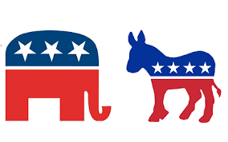
US Presidential Elections

Slide 2
Problem
What issues are associated with each candidate?
What attributes are associated to each candidate?

Slide 3
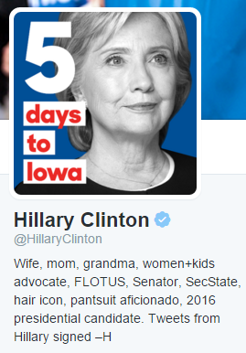
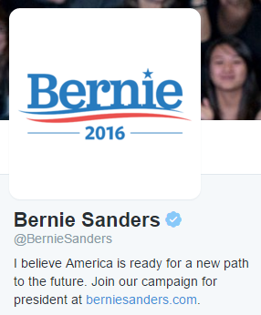

Dataset
Tweets mentioning the candidates:

Slide 4
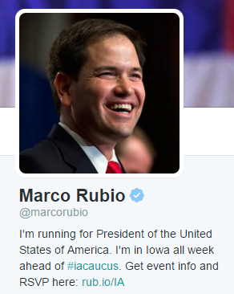
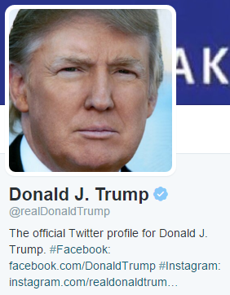
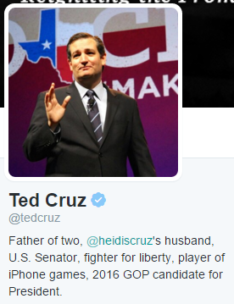

Dataset
Tweets mentioning the candidates:

Slide 5
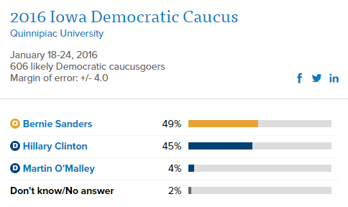
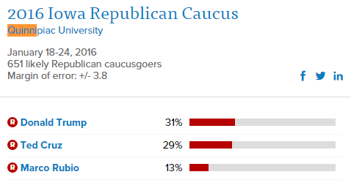
Context

Slide 6
Dataset
Test Dataset
Recent tweets post January 27, 2016
Download 10,000 tweets daily
Training Dataset
100,000 tweets per candidate
Downloaded on January 27, 2016
Subset dataset
Text, Favorite Count, Reply to Screenname, Created, Tweet ID, Screen name, Retweet Count

Slide 7
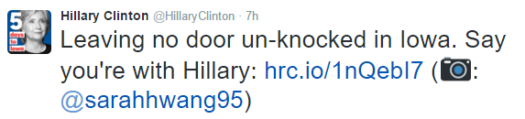
Exploration & Approach
Clean dataset
Convert Unicode to ASCII
Remove hyperlinks and twitter links
Remove users names and retweet indicators

Slide 8
Exploration & Approach
Clean dataset
Convert to lowercase
Remove English stopwords
Remove punctuation and whitespace
Remove tags (\n)
Preserve percentage numbers (polls, top1%...)
Preserve hashtags

Slide 9
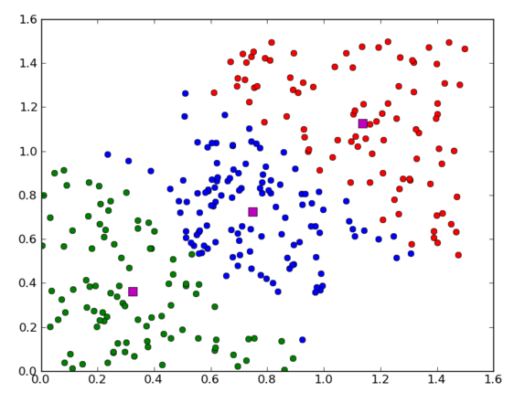
Exploration & Approach
Normalize data using TfIdf
Remove sparse terms
Plot data to identify K
K-means clustering on dtm
Process each candidate individually

Slide 10
Current Status
Training database downloaded
Clean up code prototype

Slide 11
Next Steps
Download test datasets daily
Sample 500 tweets
Calculate tdidf, reduce sparsity
Plot data to identify K
Create clusters from training dataset
Process each candidate individually
Train the data
Apply the model to test data
Evaluation

